Slide 1
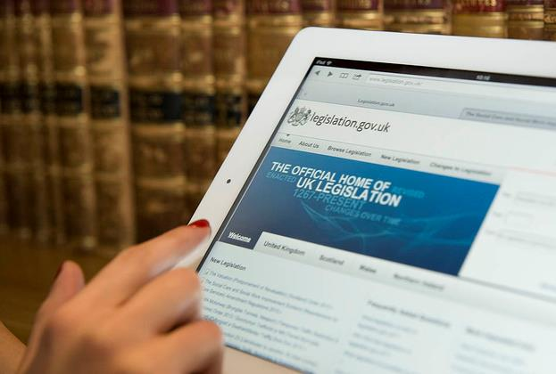
Thinking Ahead About Digital Archiving
John Sheridan
Digital Director
Notes:
Thinking Ahead About Digital Archiving
John Sheridan, Digital Director, The National Archives
The data we create and manage forms part of the public record. Records are not just documents they often and increasingly, datasets and code. With digital transformation the order of the day and generations of technology changing more rapidly than ever before, how we do we ensure the information we create today can be accessed and used tomorrow? The National Archives is tackling the challenges of digital preservation, ensuring continued access to digital information in the future. We play an active role in storing and preserving digital material created by UK government.
This presentation will explore how digital technologies are changing the nature of the record and what we need to do as we embrace the opportunities of today’s technologies, to secure the record for the future.

Slide 2
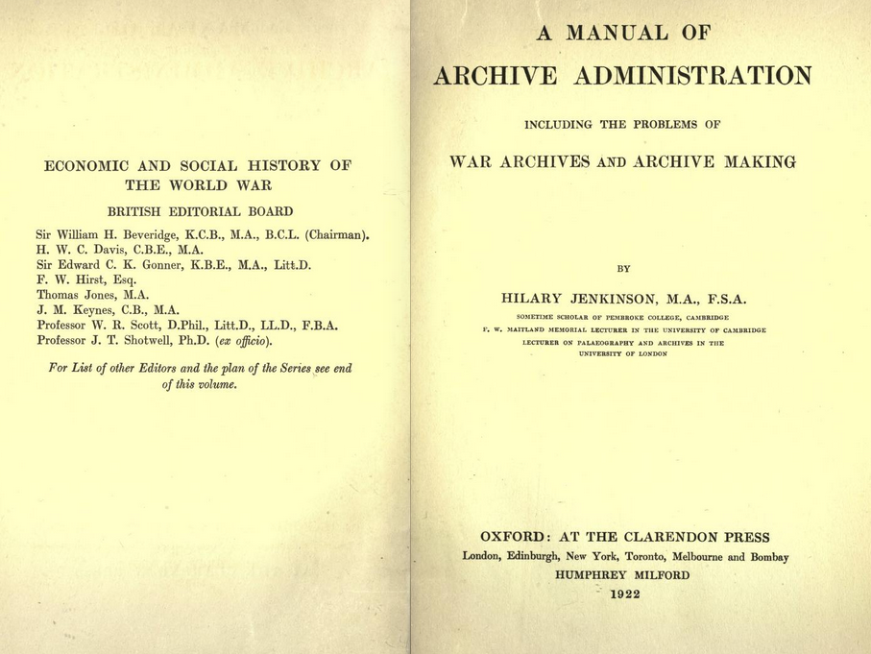


Slide 3

Notes:
Infused digital

Slide 4
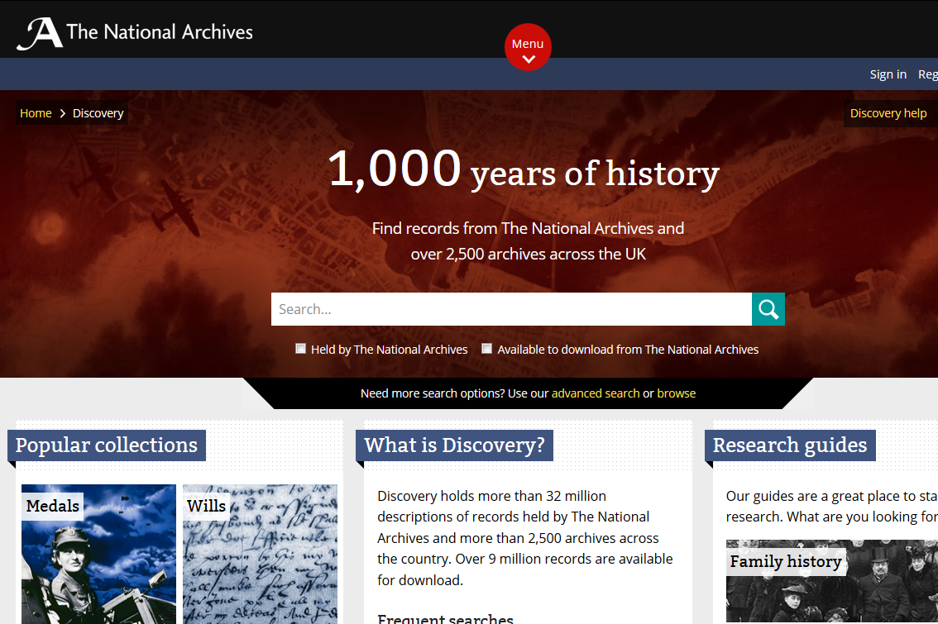
Notes:
Digital transformation of the physical archive; online catalogues and guides, digitisation, working with commercial partners

Slide 5
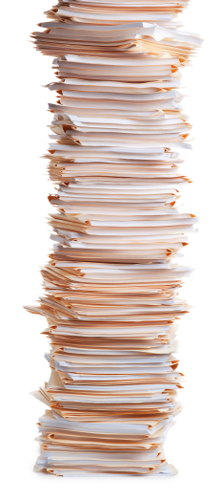
Notes:
The danger is that our thinking and our practice is paper all the way down.

Slide 6

Notes:
We digitally simulate paper – what looks like a record is what can be printed onto paper and put in a file.
This is the first generation of archives – and archivists are not alone

Slide 7
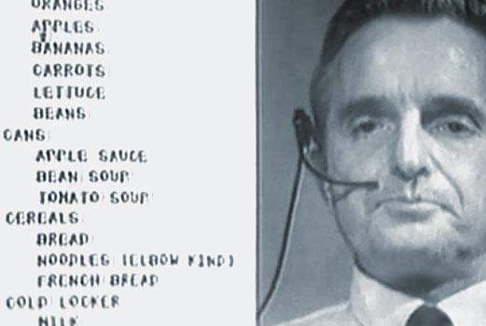
Notes:
Doug Englebart’s demo – the first mouse; wordprocessor

Slide 8
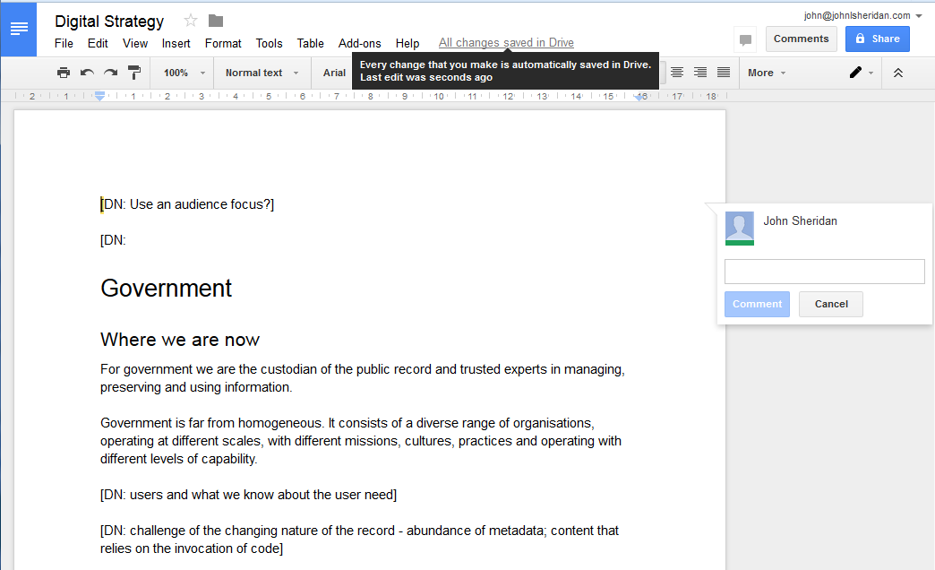
Notes:
Shift away from tools that simulate paper, to software for collaboration

Slide 9

Notes:
Data are records; structured datasets can be records;

Slide 10
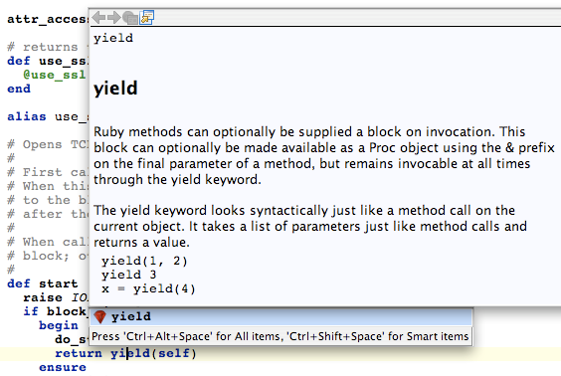
Notes:
Code can be records too – particular the code we use to make decisions!
This is important as we build

Slide 11

Notes:
In a cloud context, architecture’s are starting to look very different too.
The relentless march of commoditisation; platform as a service – databases; serverless architectures – will require new approaches to preservation

Slide 12
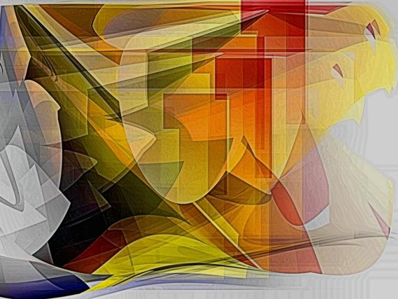
DIGITAL
IS
DIFFERENT

Slide 13

DISRUPT
OR BE DISRUPTED
PICK ONE

Slide 14
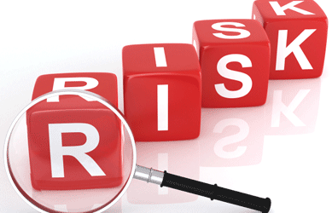
Notes:
Preservation is about risk management
Easy over one or two generations of technology; harder in the long run;
Not yet a commodity – what gets commoditised is going to be driven by economic considerations and the market (using widely deployed software helps)

Slide 15

Notes:
Trust – not changed

Slide 16




How the disruptive digital archive provides value
We will provide value
to our users
for all types of digital record
so that
Preserve
Trusted records are kept safe for the future, so they can always be used
Contextualise
Records can be understood in the context of creation and continuing use
Open records are available and can be produced for users
Present
There’s an ability to compute over all of the records for research + discovery
Enable Use

Slide 17
Opportunity to provide value at different times
Digital Archive
Preserve
Contextualise
Present
Enable Use
Time
Physical Archive
Preserve
Transfer
Present
Time

Slide 18
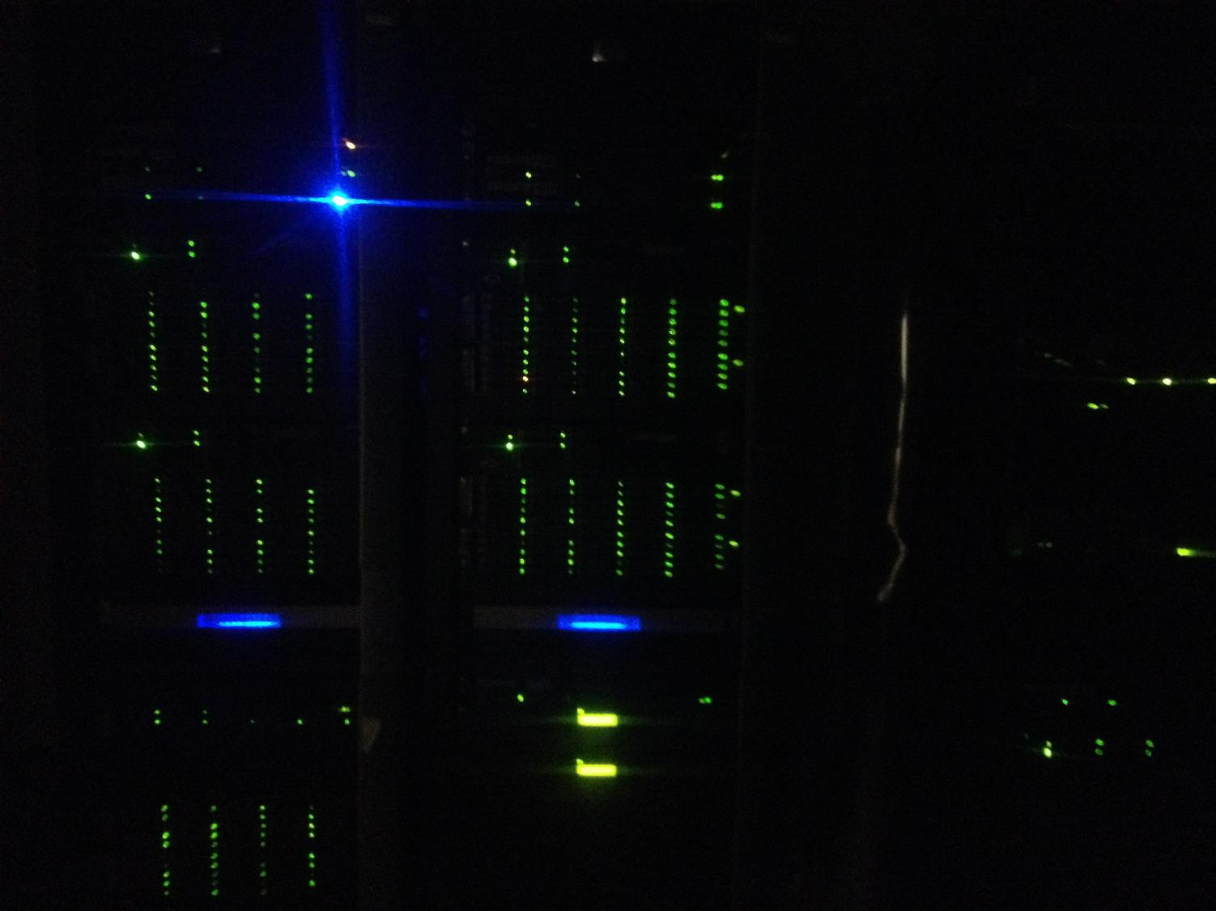

Slide 19
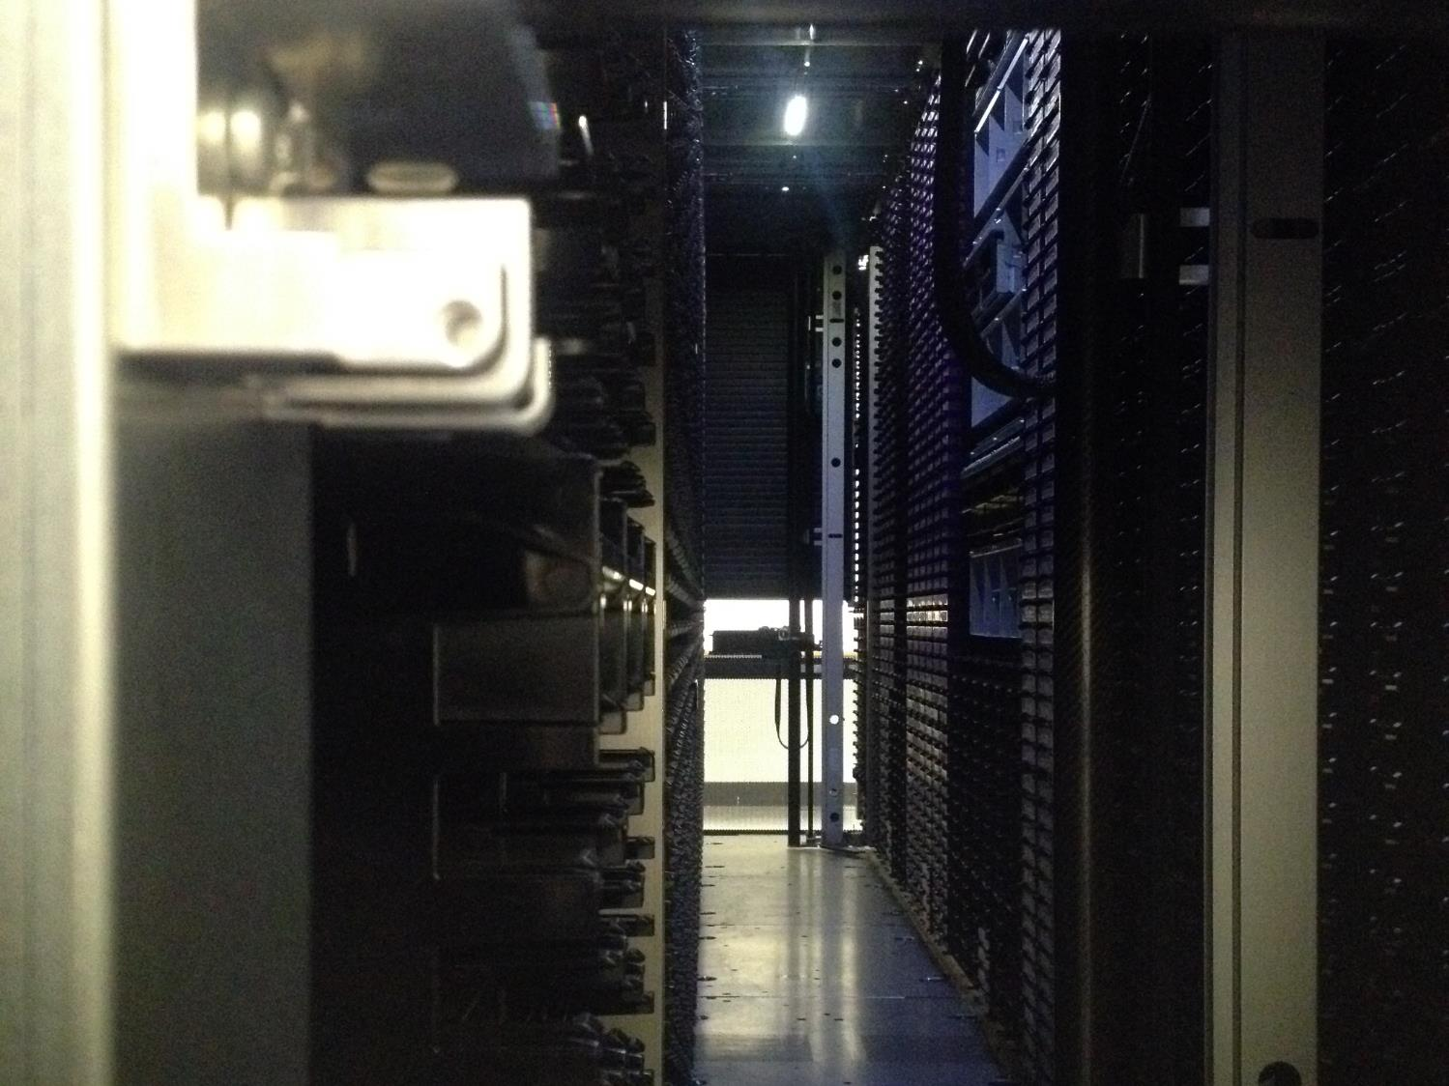

Slide 20
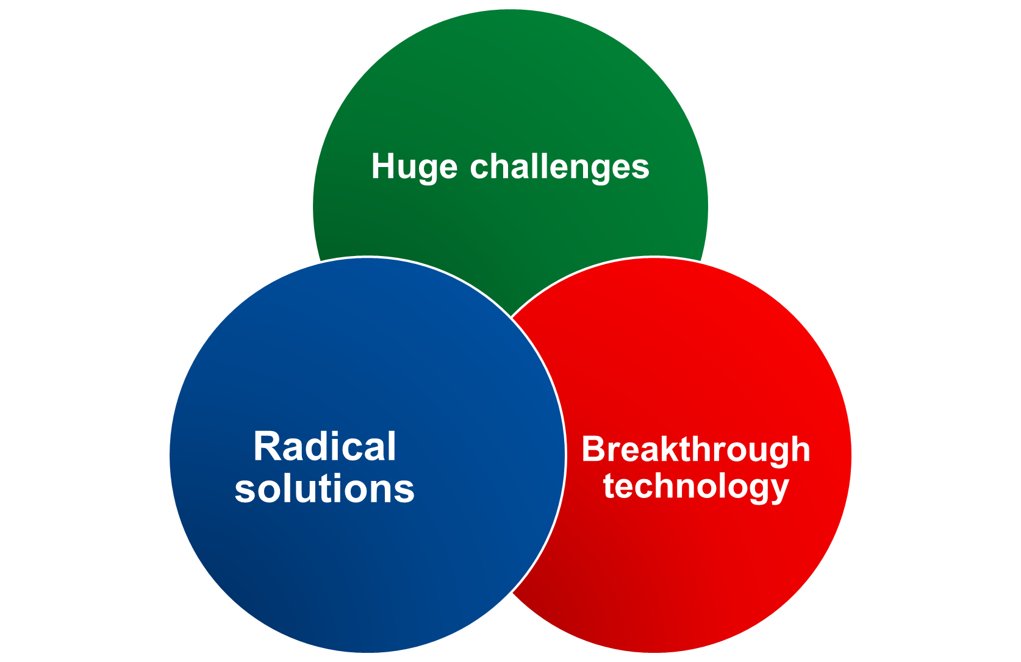

Slide 21


